Slide 1
DRDO DGRE
Vision Based Obstacle Avoidance Drone

Slide 2
Modules setup
Image processing node
Drone movement controller
Marker Detection and Landing Node

Slide 3
Image Processing node Workflow
Depth Image
(640x480)
(0-10m)
Crop
Convert to grayscale(0-255)
Center coordinates of free space
Contour detection
Binary Thresholding

Slide 4
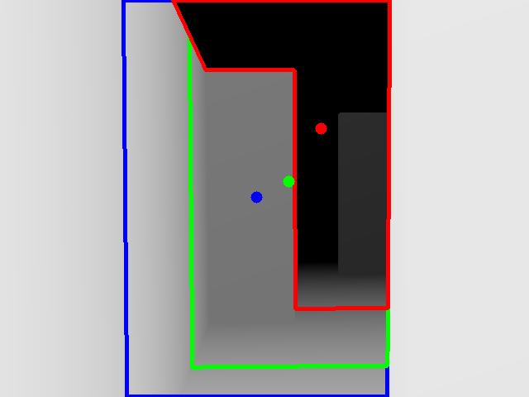

Slide 5
Movement Controller
Are there
any Obstacle on Left / Right Edge?
Is there Significant difference?
Start
Yes
Slide Right
Left > Right
No
Right > Left
Slide Left
No
Else
Yaw opposite to current Direction
Else
Is yaw aligned?
Yes
Is height aligned?
Yes
Move Forward
No
No
Adjust yaw
Adjust Height

Slide 6
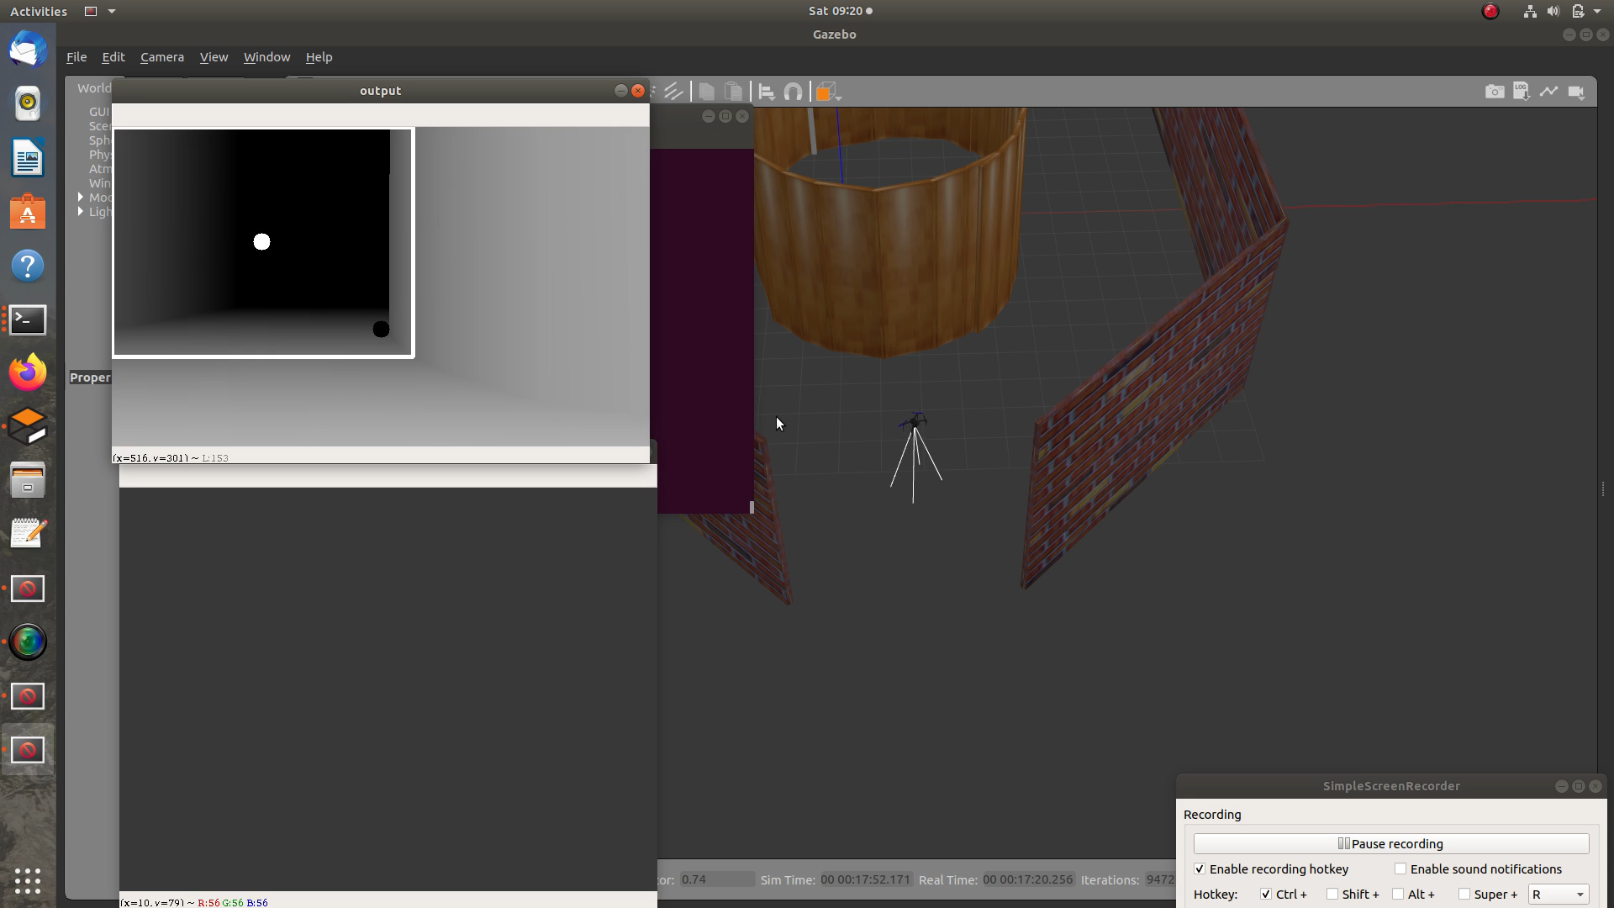
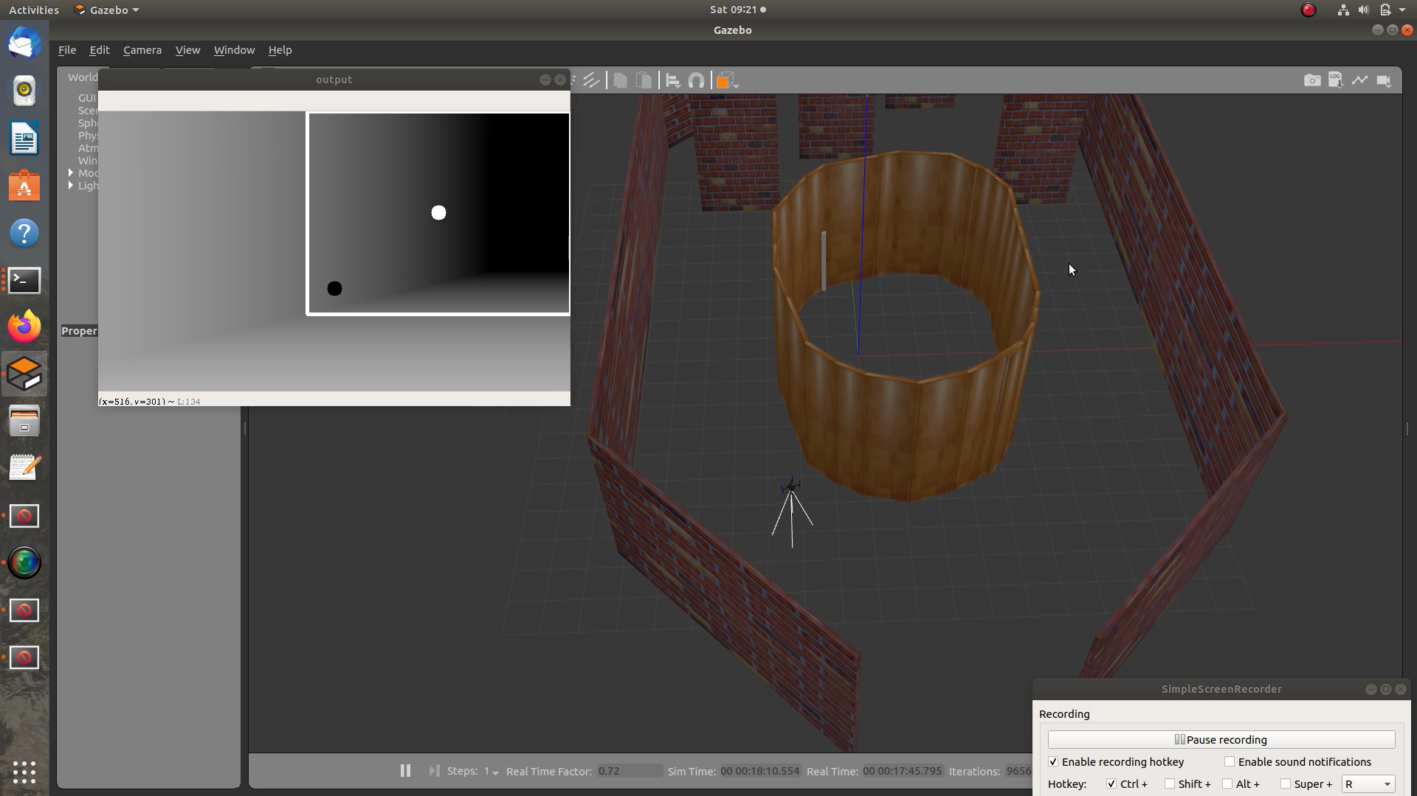
Movement Controller

Slide 7
ArUco Precision Landing Module
RGB Image from bottom facing camera
Detection of aruco markers
Set point calculation
and
Vector Generation
Land when above aruco
Move drone above marker

Slide 8
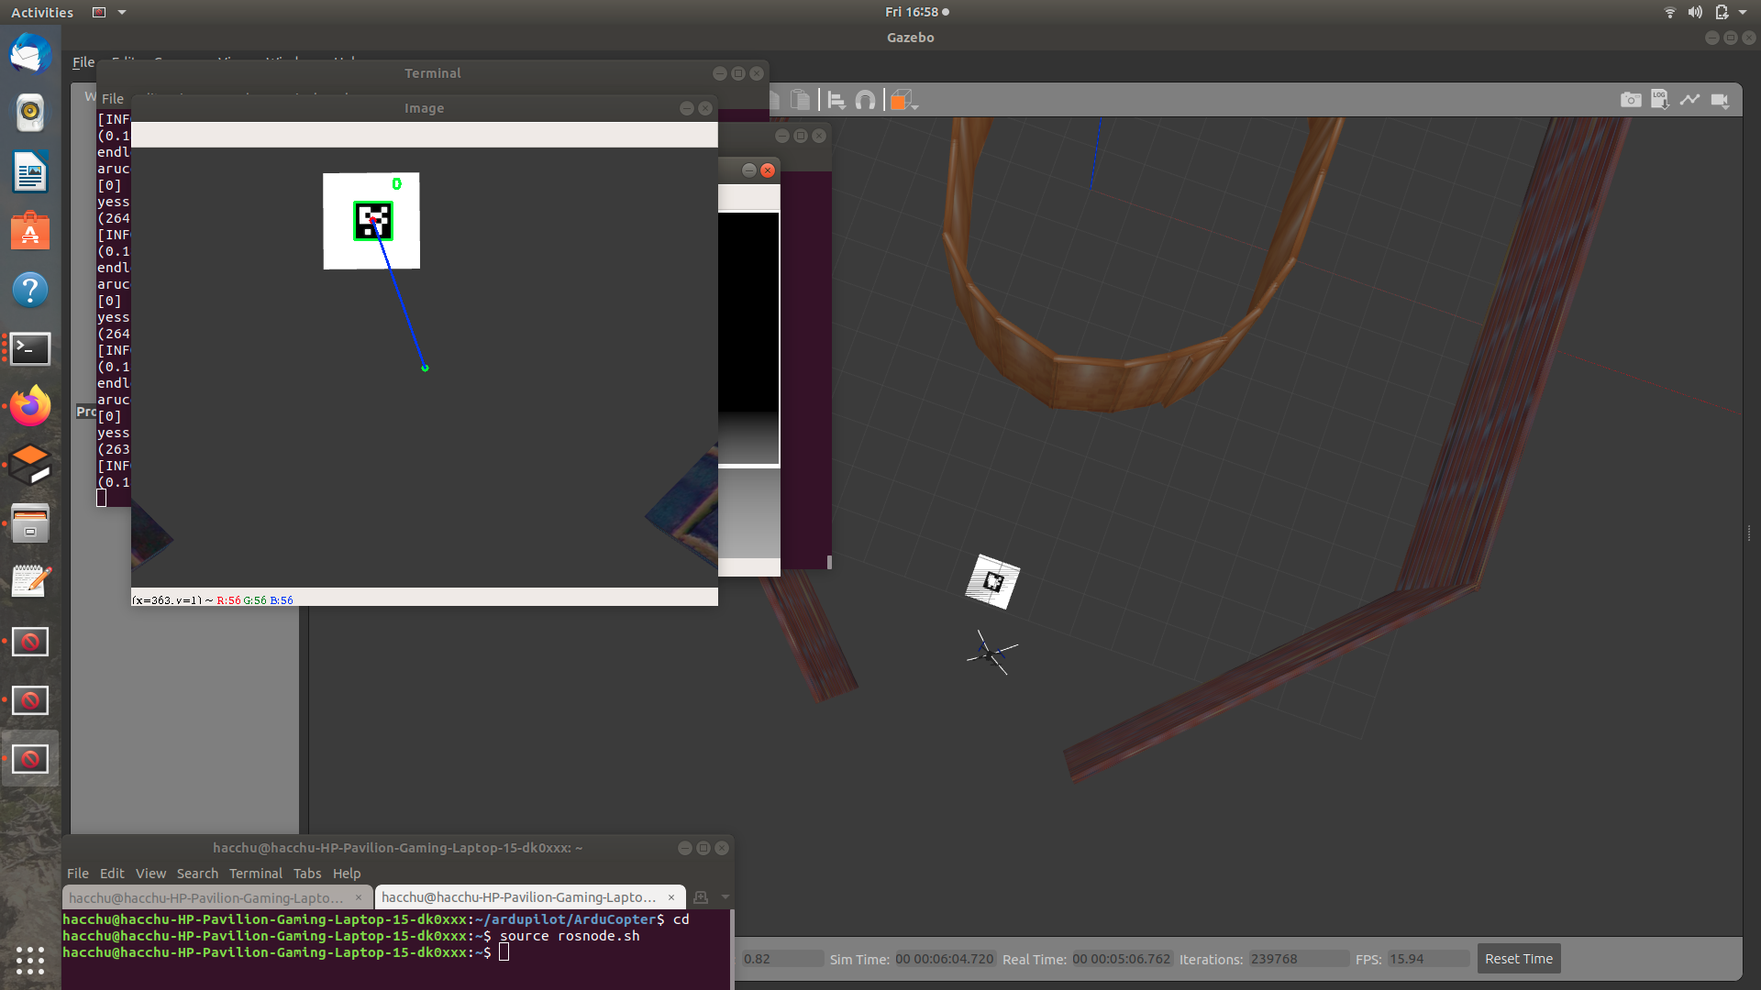
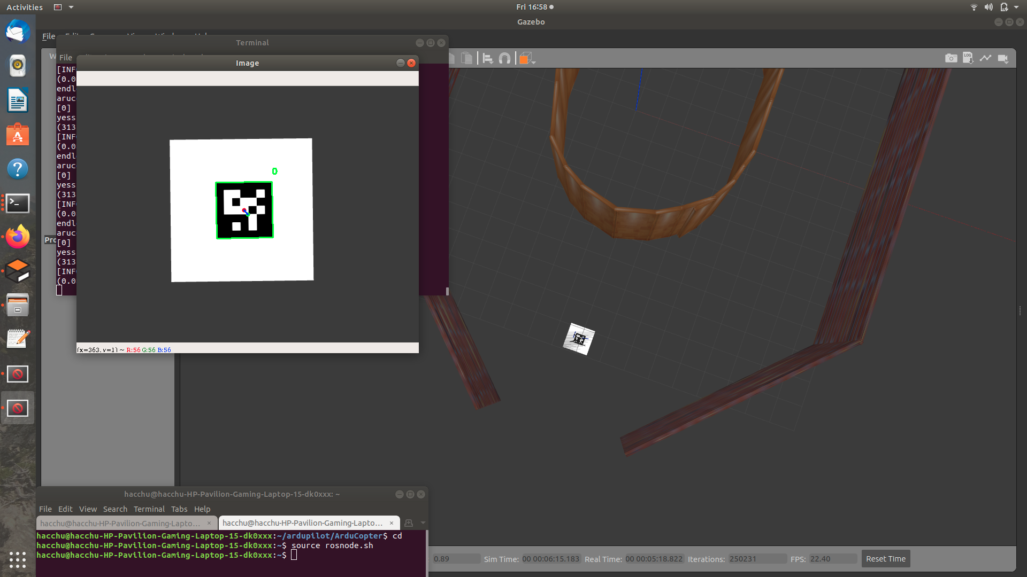
ArUco Landing Module

Slide 9
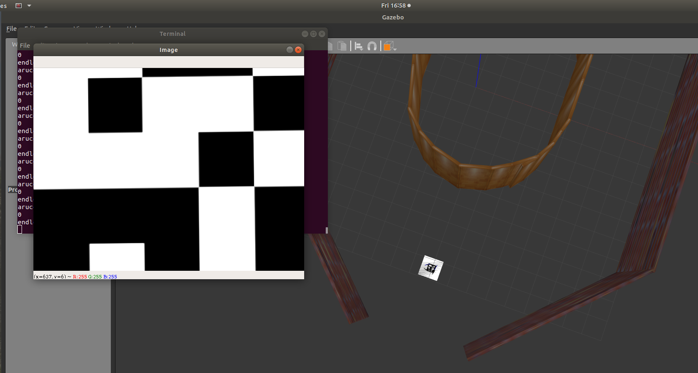

Slide 10
Novel Features
Minimal use of libraries and open source code.
Less computation intensive.
Ability to add other features due to computational headroom.

Slide 11
Weighted Vector - Approach and shortcomings
Depth image
Weighted Pixel Averaging
Drone moves opposite to obstacle vector
Obstacle Vector Generation

Slide 12
Deep Learning - Approach and shortcomings
Problem Formulation
Data Collection
Training
Analysis
Improvements
Train a DL Model which takes a depth image as an input and gives a velocity vector as an output.
Data was collected using the training worlds and manually planning the path through the obstacles and saving images and its corresponding vector.
Trained several different classical ConvNet architectures like ResNet, Inception but could not achieve accurate results using those models.
When analysing our models, we found that estimating direction from a single image is not accurate.
When trying to improve the algorithm we found that using Time Series ConvNets and giving the model a sequence of images as an input rather than a single image can be more fruitful.

Slide 13
Future improvements
3D Mapping of the environment.
A more robust algorithm that can work in travelling through small spaces, small obstacles as well as abrupt turns.
Improving the solution time.
Developing a end-to-end DL model which can take RGB camera feed as an input and can avoid obstacles.

Slide 14
Q&A

Slide 15
Thank You

